Slide 1


The King of Static Analysis: Decompilers
CSE 598 - Applied Program Analysis and Debugging, Fall 2025
Zion Leonahenahe Basque
Arizona State University

Slide 2
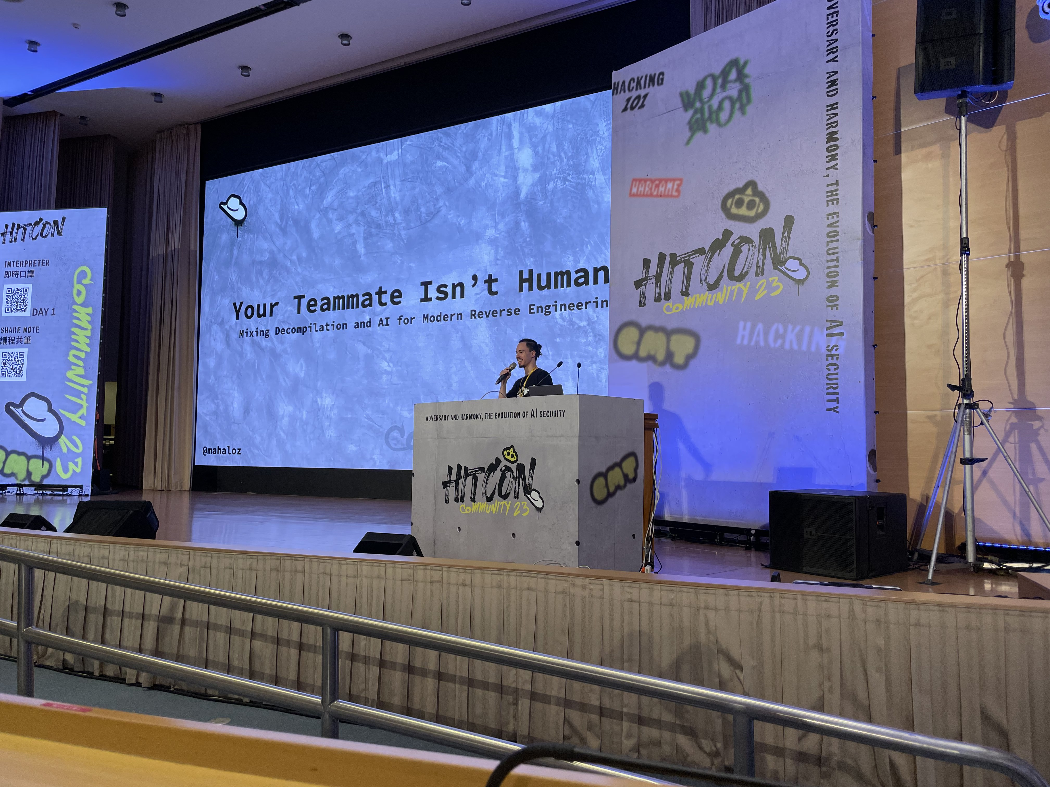

$ whoami
Your TA for this semester
A senior PhD student, studying reverse engineering
A decompiler author, developer, and travelling speaker
Shellphish hacker (known for the $3 million we won from DARPA)

Slide 3
Different ways to analyze programs
Dynamic
Symbolic
Static
State representation

Slide 4
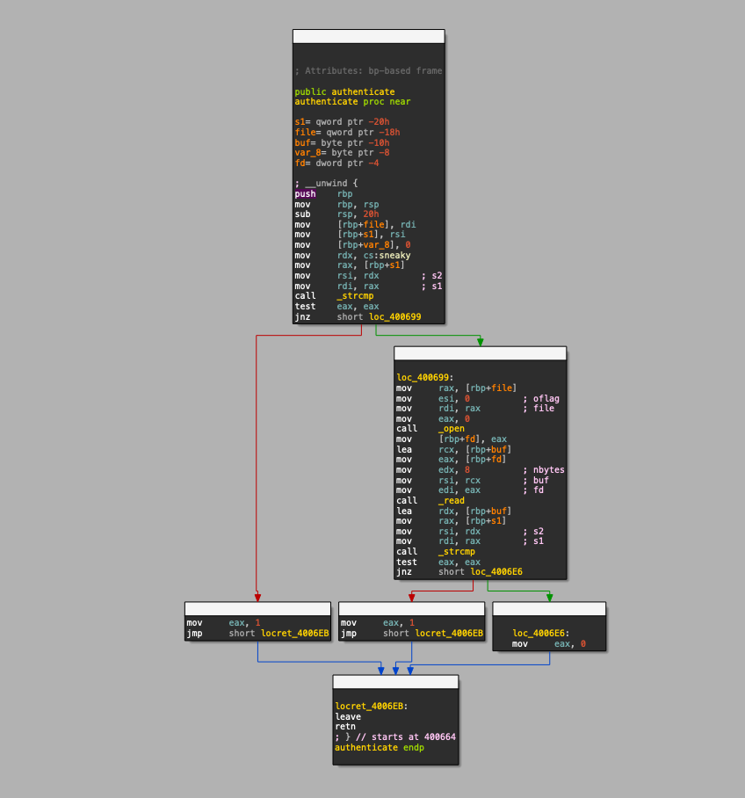
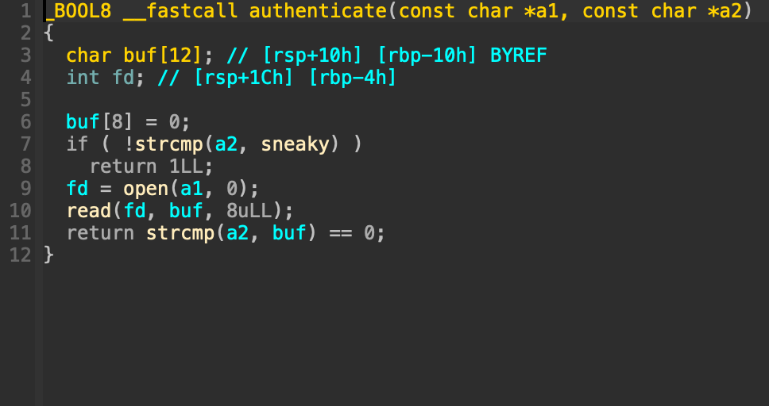
Static analyses
Disassembly
String Searching
Decompilation
Grep
Difficulty to Implement

Slide 5



Decompilers: when to use them?

Slide 6

Decompilers: when to use them?

Slide 7
Decompilers: when to use them?
🤯

Slide 8
Decompilation: the source-like solution
if (welcome) puts("hello!"); puts("goodbye"); return 0;

Slide 9




Why get the source code?
if(...) { // code } else { // other code }

Slide 10
But getting the source is not trivial…
if (welcome) puts("hello!"); puts("goodbye"); return 0;

Slide 11
But getting the source is not trivial…
if (welcome) puts("hello!"); puts("goodbye"); return 0;

Slide 12

Compilers strip programs of semantics!
Source Code
IDA Pro 9
int main (int argc, char **argv) { // ... if (max_width_option) { max_width = xdectoumax(...); } if (goal_width_option) { goal_width = xdectoumax(...); if (max_width_option == NULL) max_width = goal_width + 10; } else { goal_width = max_width * (2 * (100 - LEEWAY) + 1) / 200; } // ... }
int __cdecl main(int argc, const char **argv) { // ... if ( v3 ) { v12 = dcgettext(...); v13 = xdectoumax(..., v12); max_width = v13; if ( v7 ) { v14 = dcgettext(...); goal_width = xdectoumax(..., v14); goto LABEL_37; } goto LABEL_50; } if ( !v7 ) { LABEL_50: goal_width = 187 * max_width / 200; goto LABEL_37; } v27 = dcgettext(...); goal_width = xdectoumax(..., v27); max_width = goal_width + 10; LABEL_37: // ... }

Slide 13
Compilers strip programs of semantics: variables
Source Code
IDA Pro 9
int main (int argc, char **argv) { // ... if (max_width_option) { max_width = xdectoumax(...); } if (goal_width_option) { goal_width = xdectoumax(...); if (max_width_option == NULL) max_width = goal_width + 10; } else { goal_width = max_width * (2 * (100 - LEEWAY) + 1) / 200; } // ... }
int __cdecl main(int argc, const char **argv) { // ... if ( v3 ) { v12 = dcgettext(...); v13 = xdectoumax(..., v12); max_width = v13; if ( v7 ) { v14 = dcgettext(...); goal_width = xdectoumax(..., v14); goto LABEL_37; } goto LABEL_50; } if ( !v7 ) { LABEL_50: goal_width = 187 * max_width / 200; goto LABEL_37; } v27 = dcgettext(...); goal_width = xdectoumax(..., v27); max_width = goal_width + 10; LABEL_37: // ... }

Slide 14
Compilers strip programs of semantics: code flow
Source Code
IDA Pro 9
int main (int argc, char **argv) { // ... if (max_width_option) { max_width = xdectoumax(...); } if (goal_width_option) { goal_width = xdectoumax(...); if (max_width_option == NULL) max_width = goal_width + 10; } else { goal_width = max_width * (2 * (100 - LEEWAY) + 1) / 200; } // ... }
int __cdecl main(int argc, const char **argv) { // ... if ( v3 ) { v12 = dcgettext(...); v13 = xdectoumax(..., v12); max_width = v13; if ( v7 ) { v14 = dcgettext(...); goal_width = xdectoumax(..., v14); goto LABEL_37; } goto LABEL_50; } if ( !v7 ) { LABEL_50: goal_width = 187 * max_width / 200; goto LABEL_37; } v27 = dcgettext(...); goal_width = xdectoumax(..., v27); max_width = goal_width + 10; LABEL_37: // ... }

Slide 15
Compilers strip programs of semantics: functions?!?!?
Source Code
IDA Pro 9
int main (int argc, char **argv) { // ... if (max_width_option) { max_width = xdectoumax(...); } if (goal_width_option) { goal_width = xdectoumax(...); if (max_width_option == NULL) max_width = goal_width + 10; } else { goal_width = max_width * (2 * (100 - LEEWAY) + 1) / 200; } // ... }
int __cdecl main(int argc, const char **argv) { // ... if ( v3 ) { v12 = dcgettext(...); v13 = xdectoumax(..., v12); max_width = v13; if ( v7 ) { v14 = dcgettext(...); goal_width = xdectoumax(..., v14); goto LABEL_37; } goto LABEL_50; } if ( !v7 ) { LABEL_50: goal_width = 187 * max_width / 200; goto LABEL_37; } v27 = dcgettext(...); goal_width = xdectoumax(..., v27); max_width = goal_width + 10; LABEL_37: // ... }

Slide 16
Compilers strip programs of semantics: functions?!?!?
Source Code
IDA Pro 9
int main (int argc, char **argv) { // ... if (max_width_option) { max_width = xdectoumax(...); } if (goal_width_option) { goal_width = xdectoumax(...); if (max_width_option == NULL) max_width = goal_width + 10; } else { goal_width = max_width * (2 * (100 - LEEWAY) + 1) / 200; } // ... }
int __cdecl main(int argc, const char **argv) { // ... if ( v3 ) { v12 = dcgettext(...); v13 = xdectoumax(..., v12); max_width = v13; if ( v7 ) { v14 = dcgettext(...); goal_width = xdectoumax(..., v14); goto LABEL_37; } goto LABEL_50; } if ( !v7 ) { LABEL_50: goal_width = 187 * max_width / 200; goto LABEL_37; } v27 = dcgettext(...); goal_width = xdectoumax(..., v27); max_width = goal_width + 10; LABEL_37: // ... }

Slide 17
And so, people have invested time and money in decompilers!

Slide 18

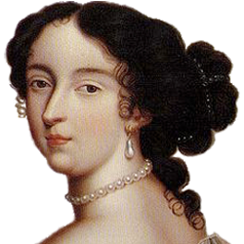
Industry investment
Hex-Rays (IDA Pro), ~8k a year license
Binary Ninja, millions in investments from government contracts
Financial support at conferences to develop decompilers

Slide 19


Government investment
Millions in funding from DARPA
https://www.darpa.mil/research/programs/assured-micropatching
https://www.darpa.mil/research/programs/cyber-grand-challenge
NSA’s creation of Ghidra, rumored to be in development for decades

Slide 20


Scientific investment
Academics started decompiler research in the 60s!
Foundations laid in the 90s
Established core methodologies for decompilation…

Slide 21
How do decompilers work?
1. Control Flow Graph
Recovery (Lifting)
2. Type & Variable
Recovery
3. Control Flow Structuring
int v1;
if (v1) puts("hello!"); puts("goodbye"); return 0;

Slide 22
Modern decompilation areas¹
CFG Recovery
Variables & Types
Control Flow Structuring
if (a && b) puts("1"); puts("2"); if (b) puts("3"); return 0;
Application
Evaluation
[1]: https://decompilation.wiki/fundamentals/overview/

Slide 23
So, how do I make a decompiler?

Slide 24
CFG Recovery & Lifting
1. Control Flow Graph
Recovery (Lifting)
2. Type & Variable
Recovery
3. Control Flow Structuring
int v1;
if (v1) puts("hello!"); puts("goodbye"); return 0;

Slide 25
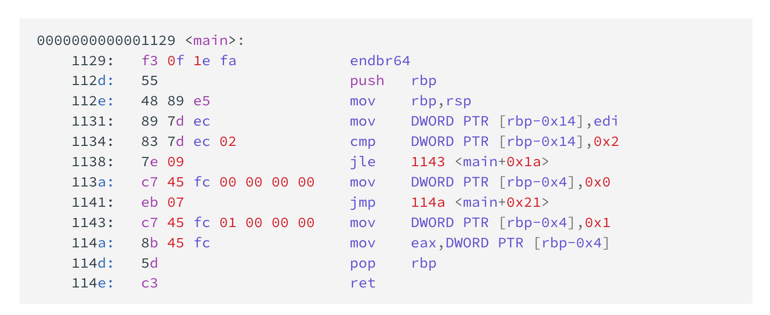
CFG Recovery: Disassembling - Linear
decoding

Slide 26
CFG Recovery: Disassembling - Recursive
decoding

Slide 27
CFG Recovery: Lots of previous works and tools
Disassemble [2], [6]
Lift to Intermediate Representation [3]
Identify Function Boundaries [4]
Resolve Indirect Control Flow [5], [6]
More Info: https://decompilation.wiki/fundamentals/cfg-recovery/overview/
[2] Flores-Montoya, Antonio, and Eric Schulte. "Datalog disassembly." Proceedings of the 29th USENIX Conference on Security Symposium. 2020.
[3] Y. Shoshitaishvili et al., "SOK: (State of) The Art of War: Offensive Techniques in Binary Analysis," 2016 IEEE Symposium on Security and Privacy (SP), San Jose, CA, USA, 2016.
[4] Di Federico, Alessandro, Mathias Payer, and Giovanni Agosta. "rev. ng: a unified binary analysis framework to recover CFGs and function boundaries." Proceedings of the 26th International Conference on Compiler Construction. 2017.
[5] Kim, Sun Hyoung, et al. "Refining Indirect Call Targets at the Binary Level." NDSS. 2021.
[6] Pang, Chengbin, et al. "Ground Truth for Binary Disassembly is Not Easy." 31st USENIX Security Symposium (USENIX Security 22). 2022.

Slide 28
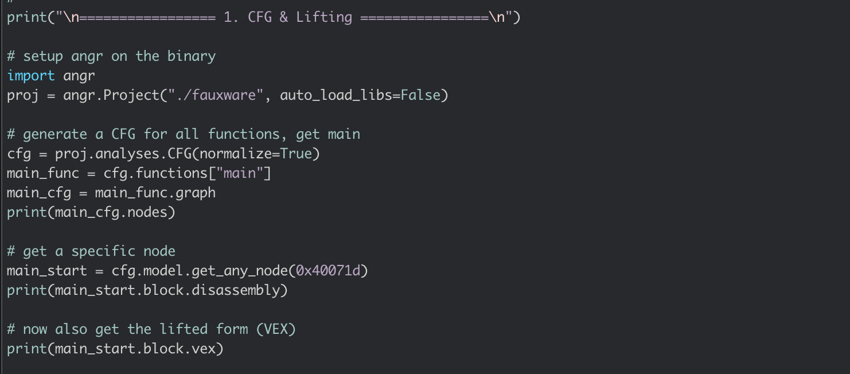
Try it!

Slide 29
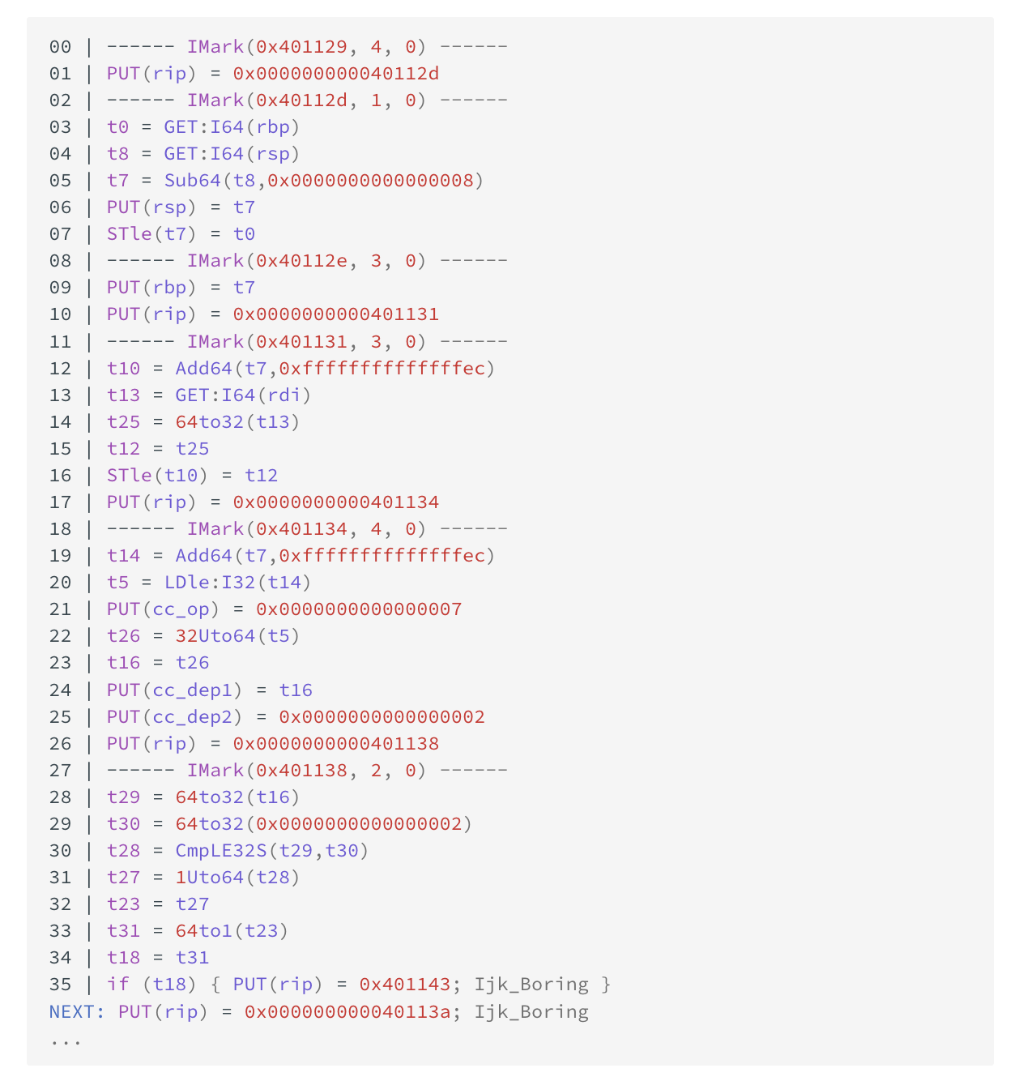
What lifted code looks like…

Slide 30
Type & Variable Recovery
1. Control Flow Graph
Recovery (Lifting)
2. Type & Variable
Recovery
3. Control Flow Structuring
int v1;
if (v1) puts("hello!"); puts("goodbye"); return 0;

Slide 31
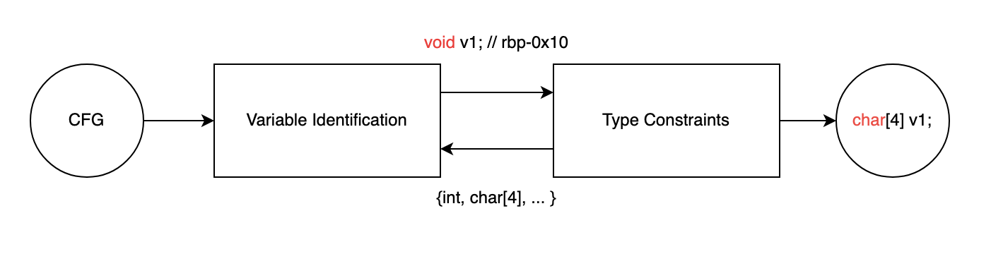
Type & Variable Recovery

Slide 32
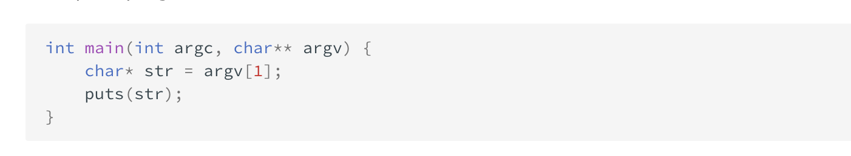
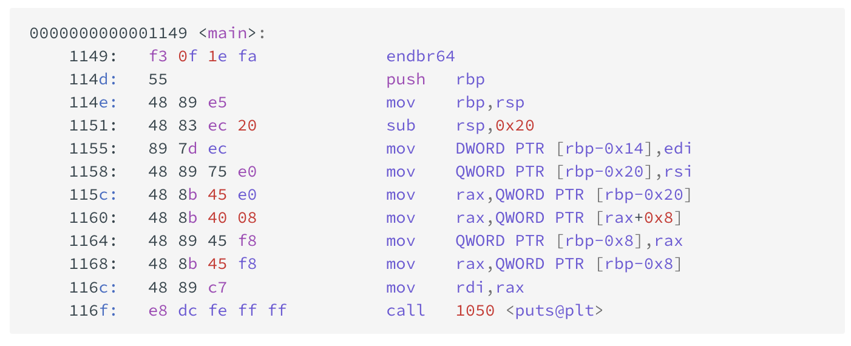
Type & Variable Recovery: Example

Slide 33
Type & Variable Recovery: Example

Slide 34
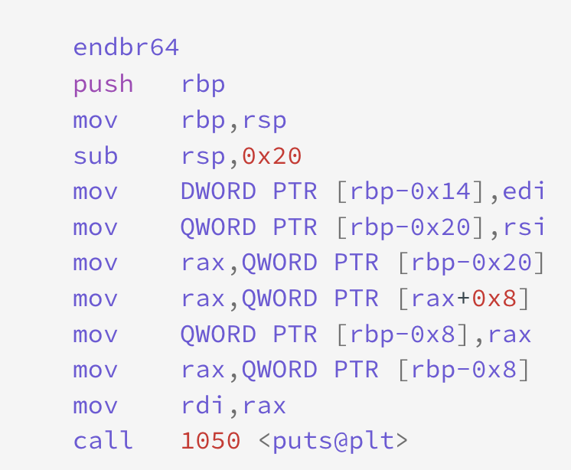
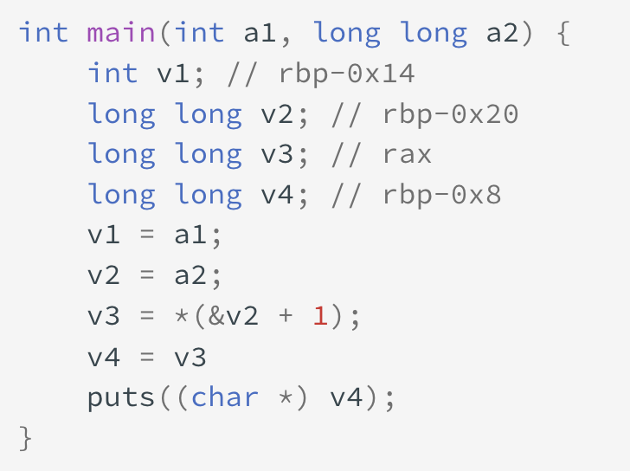
Type & Variable Recovery: Example

Slide 35
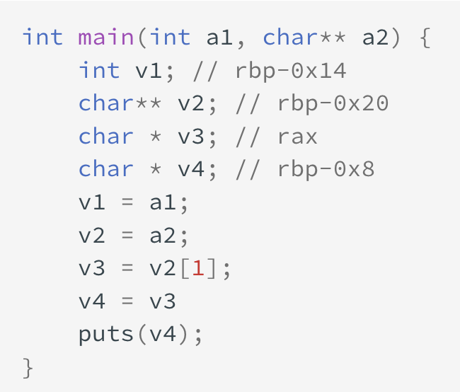
Type & Variable Recovery: Example
Use known prototypes to propagate type info

Slide 36
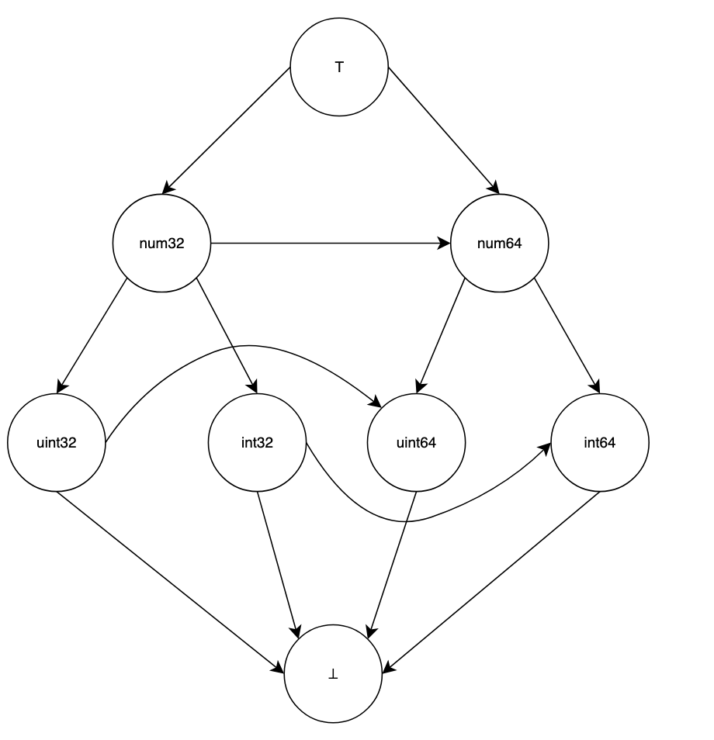
You can also use more complicated lattices

Slide 37
Type & Var Recovery: previous works
Dependency Analysis [7], [8]
Storage Location [7]
Machine Learning [9]
More Info: https://decompilation.wiki/fundamentals/type-recovery/overview/
[7] Lee, JongHyup, Thanassis Avgerinos, and David Brumley. "TIE: Principled reverse engineering of types in binary programs." (2011).
[8] Noonan, Matt, Alexey Loginov, and David Cok. "Polymorphic type inference for machine code." Proceedings of the 37th ACM SIGPLAN Conference on Programming Language Design and Implementation. 2016.
[9] Chen, Qibin, et al. "Augmenting decompiler output with learned variable names and types." 31st USENIX Security Symposium (USENIX Security 22). 2022.

Slide 38
Control Flow Structuring
1. Control Flow Graph
Recovery (Lifting)
2. Type & Variable
Recovery
3. Control Flow Structuring
int v1;
if (v1) puts("hello!"); puts("goodbye"); return 0;

Slide 39
The end of the pipeline: control flow structuring
int v1;
if (v1) puts("hello!"); puts("goodbye"); return 0;
Control Flow Structuring

Slide 40
Background: schema-based structuring

Slide 41
Background: schema-based structuring
if (a) puts("1"); puts("2");
if (a) puts("1"); else puts("2"); puts("3")
switch(a) { case 1: break; case 2: break; default: break; } puts("1");
do { puts("1"); } while(a); puts("2");

Slide 42
Background: schema-based structuring
Decompilation
if (a) puts("1"); puts("2");
if (a) puts("1"); else puts("2"); puts("3")
switch(a) { case 1: break; case 2: break; default: break; } puts("1");
do { puts("1"); } while(a); puts("2");

Slide 43
Background: schema-based structuring
Compilation
if (a) puts("1"); puts("2");
if (a) puts("1"); else puts("2"); puts("3")
switch(a) { case 1: break; case 2: break; default: break; } puts("1");
do { puts("1"); } while(a); puts("2");

Slide 44
Background: schema-based structuring

Slide 45
Background: schema-based structuring
if-then-else

Slide 46
Background: schema-based structuring
if-then-else

Slide 47
Background: schema-based structuring
if-then-else

Slide 48
Background: schema-based structuring
if-then
if-then-else

Slide 49
Background: schema-based structuring
if-then
if-then-else

Slide 50
Background: schema-based structuring
if-then
if-then-else

Slide 51
Background: schema-based structuring
“Virtualization”
if-then-else

Slide 52
Background: schema-based structuring
sequence
“Virtualization”
if-then-else

Slide 53
Background: schema-based structuring
sequence
“Virtualization”
if-then-else

Slide 54
Background: schema-based structuring
if (a) goto B; // ... if (b) { B: // ... } else { // ... }

Slide 55
Structuring algorithms: schema-based
Schema-based
if (a) goto B; // ... if (b) { B: // ... } else { // ... }

Slide 56
Structuring algorithms: gotoless
Gotoless
if (~a) // ... if (a || b) { // ... } else { // ... }

Slide 57
Structuring algorithms
Schema-based
Gotoless
if (a) goto B; // ... if (b) { B: // ... } else { // ... }
if (~a) // ... if (a || b) { // ... } else { // ... }

Slide 58
Structuring differences
Source
Hex-Rays [1] (schema)
DREAM [2] (gotoless)
if (a1 && a2) { complete_job(); if (a3 == EARLY_EXIT) goto cleanup; next_job(); } refresh_jobs(); if (a2) fast_unlock(); cleanup: // ...
if ( !a1 || !a2 ) { refresh_jobs(); if ( !a2 ) goto cleanup; goto label; } complete_job(); if ( EARLY_EXIT != a3 ) { next_job(); refresh_jobs(); label: fast_unlock(); } cleanup: // ...
if (a1 && a2) { complete_job(); if (EARLY_EXIT != a3) { next_job(); refresh_jobs(); } } if (!a1 || !a2) refresh_jobs(); if (a2 && (!a1 || EARLY_EXIT != a3)) fast_unlock(); // ...
[1]: The IDA Pro disassembler and debugger. http://www.hex-rays.com/idapro/.
[2]: Yakdan, Khaled, et al. "No More Gotos: Decompilation Using Pattern-Independent Control-Flow Structuring and Semantic-Preserving Transformations." NDSS. 2015.

Slide 59
Structuring failures
Source
Hex-Rays [1] (schema)
DREAM [2] (gotoless)
if (a1 && a2) { complete_job(); if (a3 == EARLY_EXIT) goto cleanup; next_job(); } refresh_jobs(); if (a2) fast_unlock(); cleanup: // ...
if ( !a1 || !a2 ) { refresh_jobs(); if ( !a2 ) goto cleanup; goto label; } complete_job(); if ( EARLY_EXIT != a3 ) { next_job(); refresh_jobs(); label: fast_unlock(); } cleanup: // ...
if (a1 && a2) { complete_job(); if (EARLY_EXIT != a3) { next_job(); refresh_jobs(); } } if (!a1 || !a2) refresh_jobs(); if (a2 && (!a1 || EARLY_EXIT != a3)) fast_unlock(); // ...
[1]: The IDA Pro disassembler and debugger. http://www.hex-rays.com/idapro/.
[2]: Yakdan, Khaled, et al. "No More Gotos: Decompilation Using Pattern-Independent Control-Flow Structuring and Semantic-Preserving Transformations." NDSS. 2015.

Slide 60
Structuring failures
Source
Hex-Rays [1] (schema)
DREAM [2] (gotoless)
if (a1 && a2) { complete_job(); if (a3 == EARLY_EXIT) goto cleanup; next_job(); } refresh_jobs(); if (a2) fast_unlock(); cleanup: // ...
if ( !a1 || !a2 ) { refresh_jobs(); if ( !a2 ) goto cleanup; goto label; } complete_job(); if ( EARLY_EXIT != a3 ) { next_job(); refresh_jobs(); label: fast_unlock(); } cleanup: // ...
if (a1 && a2) { complete_job(); if (EARLY_EXIT != a3) { next_job(); refresh_jobs(); } } if (!a1 || !a2) refresh_jobs(); if (a2 && (!a1 || EARLY_EXIT != a3)) fast_unlock(); // ...
[1]: The IDA Pro disassembler and debugger. http://www.hex-rays.com/idapro/.
[2]: Yakdan, Khaled, et al. "No More Gotos: Decompilation Using Pattern-Independent Control-Flow Structuring and Semantic-Preserving Transformations." NDSS. 2015.

Slide 61
Structuring failures
Source
Hex-Rays [1] (schema)
DREAM [2] (gotoless)
if (a1 && a2) { complete_job(); if (a3 == EARLY_EXIT) goto cleanup; next_job(); } refresh_jobs(); if (a2) fast_unlock(); cleanup: // ...
if ( !a1 || !a2 ) { refresh_jobs(); if ( !a2 ) goto cleanup; goto label; } complete_job(); if ( EARLY_EXIT != a3 ) { next_job(); refresh_jobs(); label: fast_unlock(); } cleanup: // ...
if (a1 && a2) { complete_job(); if (EARLY_EXIT != a3) { next_job(); refresh_jobs(); } } if (!a1 || !a2) refresh_jobs(); if (a2 && (!a1 || EARLY_EXIT != a3)) fast_unlock(); // ...
[1]: The IDA Pro disassembler and debugger. http://www.hex-rays.com/idapro/.
[2]: Yakdan, Khaled, et al. "No More Gotos: Decompilation Using Pattern-Independent Control-Flow Structuring and Semantic-Preserving Transformations." NDSS. 2015.

Slide 62
Which one is the best?
Source
Hex-Rays [1] (schema)
DREAM [2] (gotoless)
if (a1 && a2) { complete_job(); if (a3 == EARLY_EXIT) goto cleanup; next_job(); } refresh_jobs(); if (a2) fast_unlock(); cleanup: // ...
if ( !a1 || !a2 ) { refresh_jobs(); if ( !a2 ) goto cleanup; goto label; } complete_job(); if ( EARLY_EXIT != a3 ) { next_job(); refresh_jobs(); label: fast_unlock(); } cleanup: // ...
if (a1 && a2) { complete_job(); if (EARLY_EXIT != a3) { next_job(); refresh_jobs(); } } if (!a1 || !a2) refresh_jobs(); if (a2 && (!a1 || EARLY_EXIT != a3)) fast_unlock(); // ...
[1]: The IDA Pro disassembler and debugger. http://www.hex-rays.com/idapro/.
[2]: Yakdan, Khaled, et al. "No More Gotos: Decompilation Using Pattern-Independent Control-Flow Structuring and Semantic-Preserving Transformations." NDSS. 2015.

Slide 63
Results: source-like decompilation (2)
Source
Hex-Rays (IDA Pro)
int main (int argc, char **argv) { // ... if (max_width_option) { max_width = xdectoumax(...); } if (goal_width_option) { goal_width = xdectoumax(...); if (max_width_option == NULL) max_width = goal_width + 10; } else { goal_width = max_width * (2 * (100 - LEEWAY) + 1) / 200; } // ... }
int __cdecl main(int argc, const char **argv) { // ... if ( v3 ) { v12 = dcgettext(...); v13 = xdectoumax(..., v12); max_width = v13; if ( v7 ) { v14 = dcgettext(...); goal_width = xdectoumax(..., v14); goto LABEL_37; } goto LABEL_50; } if ( !v7 ) { LABEL_50: goal_width = 187 * max_width / 200; goto LABEL_37; } v27 = dcgettext(...); goal_width = xdectoumax(..., v27); max_width = goal_width + 10; LABEL_37: // ... }

Slide 64
Results: source-like decompilation (2)
Source
SAILR
int main (int argc, char **argv) { // ... if (max_width_option) { max_width = xdectoumax(...); } if (goal_width_option) { goal_width = xdectoumax(...); if (max_width_option == NULL) max_width = goal_width + 10; } else { goal_width = max_width * (2 * (100 - LEEWAY) + 1) / 200; } // ... }
int main(int argc, const char **argv) { // ... if (v2) max_width = xdectoumax(..., dcgettext(...)); if (!v6) { v11 = max_width * 187; v12 = (v11 >> 31 CONCAT v11) /m 200; v13 = v12 / 0x100000000; goal_width = v12; } else { goal_width = xdectoumax(..., dcgettext(...)); if (!v2) max_width = goal_width + 10; } // ... }

Slide 65


Thank you
Zion Leonahenahe Basuqe
Arizona State University
✉️: zbasque@asu.edu
: @mahal0z
: https://github.com/angr/angr
: https://decompilation.wiki/
pip install angr angr decompile /bin/true

Slide 66
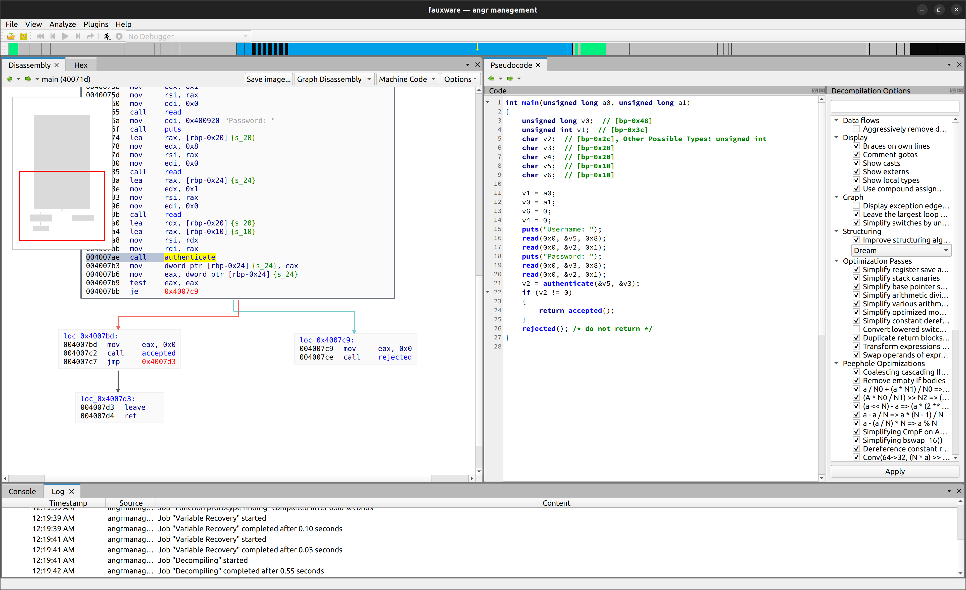
angr-management

Slide 67
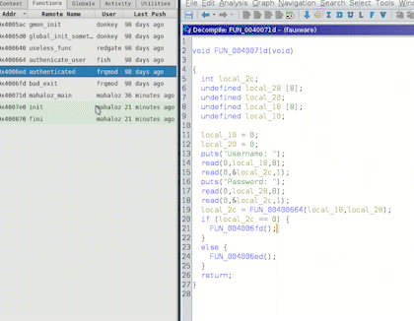
BinSync: Ghidra

Slide 68
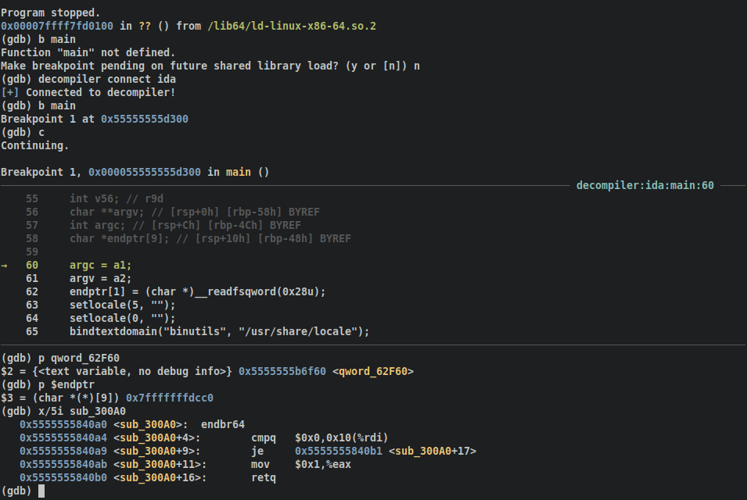
decomp2dbg

Slide 69
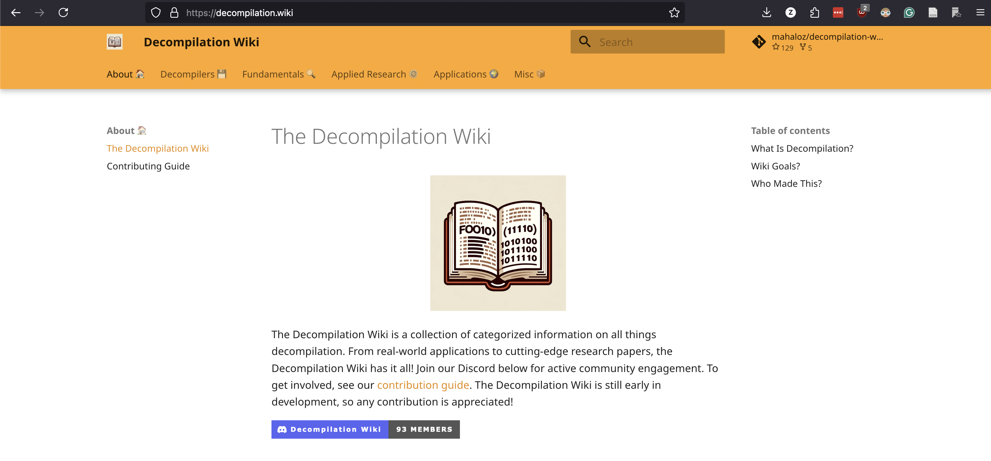
Decompilation Wiki

